Slide 1
Face Classification: A Specialized Benchmark Study
Jiali Duan, Shengcai Liao, Shuai Zhou, and Stan Z. Li
Center for Biometrics and Security Research
Institute of Automation, Chinese Academy of Sciences

Slide 2
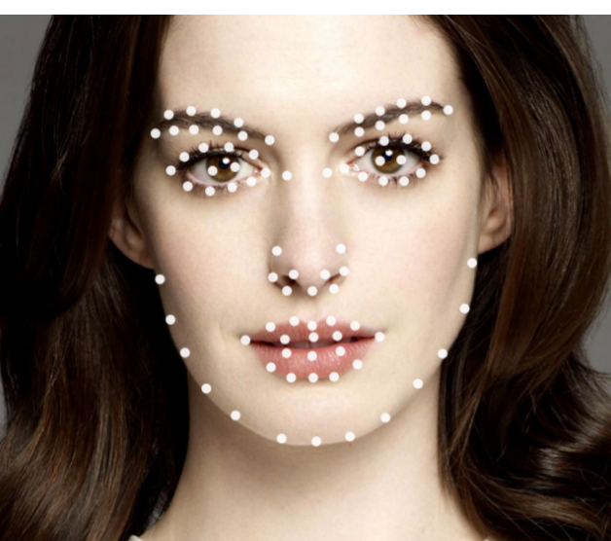
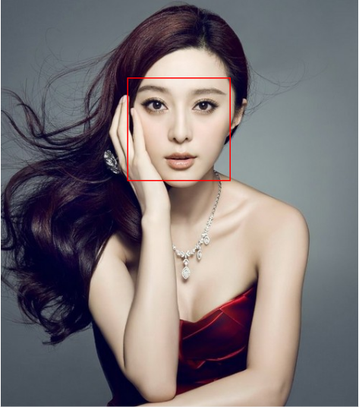
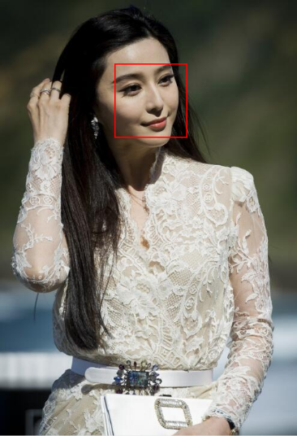
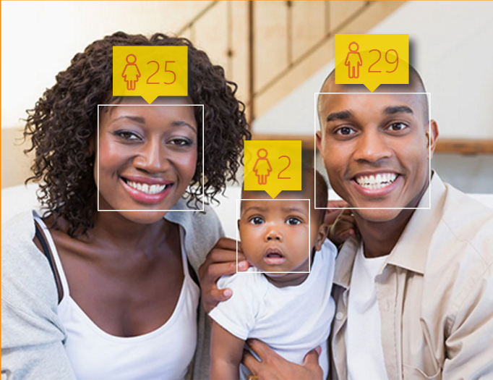
Introduction
Face detection: foundations for high-level facial analysis
Face Alignment
Face Recognition
Age Prediction
Notes:
Face detection is a key fundamental problem in facial analysis
It’s the first step for other high-level tasks such as Face Alignment, Face Recognition, Face Attribute Analysis

Slide 3
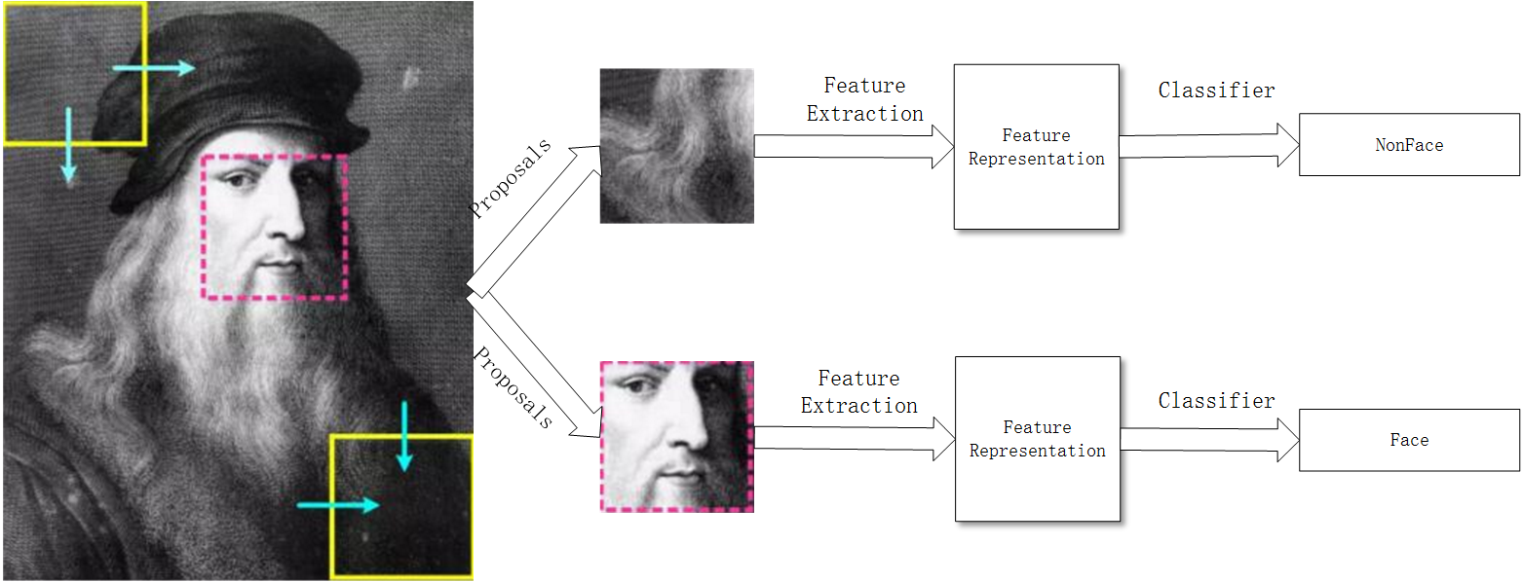
Face detection generally involves three steps:
Post-Processing
Block Generation
Face Classification

Slide 4
Drawbacks of Existing Benchmarks
Performance of Face Classification itself is hard to determine
Face detection is largely influenced by block generation and post processing methods
2. Implementing and optimizing all the three steps results in a very heavy work
Notes:
1. The performace of face detection is largely influenced by other two steps, concealing the performance of face classification.
2. Implementing and optimizing all three steps results in a very heavy work, which is a big barrier for those who only cares about classification

Slide 5
Contributions
1. Conducted a specialized benchmark study, focusing purely on face classiﬁcation
A benchmark dataset with >3.5 million samples
2. Reported performance of various feature extraction and classification methods
Poor performance even with CNN!
3. Dataset and code released
Notes:
1. We start with face proposals, and build a benchmark dataset with about 3.5 million patches for two-class face/non-face classification
2. Several baselines with respect to feature extraction methods and classification methods have been demonstrated.

Slide 6
Related Works
AFW [1]
FDDB [2]
3. WIDER FACE [3]
[1] Zhu, Xiangxin and Ramanan, Deva. Face detection, pose estimation, and landmark localization in the wild, CVPR 2012.
[2] Vidit Jain and Erik Learned-Miller. FDDB: A Benchmark for Face Detection in Unconstrained Settings. TechReport: UM-CS-2010-009, 2010
[3] Yang, Shuo and Luo, Ping and Loy, Chen Change and Tang, Xiaoou. WIDER FACE: A Face Detection Benchmark. CVPR 2016.
Notes:
Popular benchmark face dataset include: AFW [1], FDDB [2], WIDER FACE [3] benchmarks all require that researchers start from scratch

Slide 7
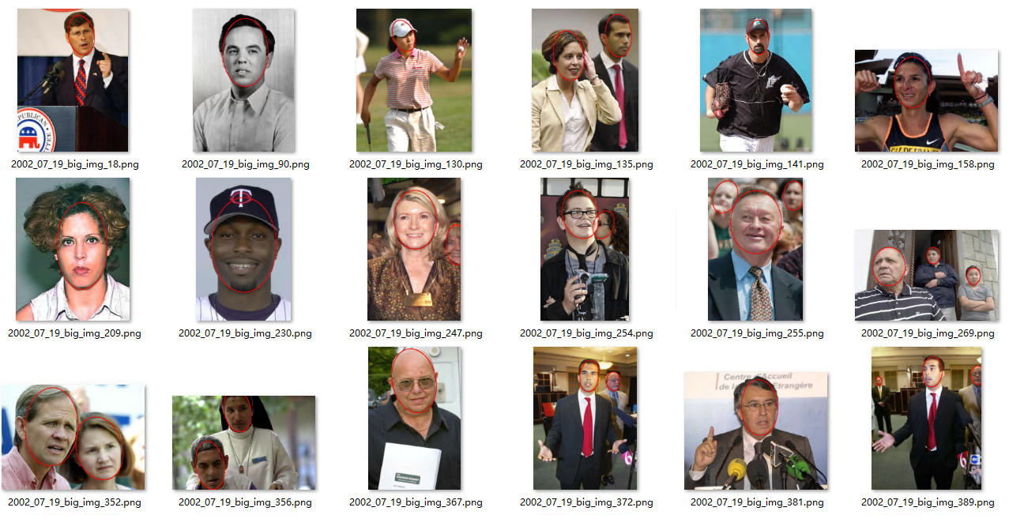
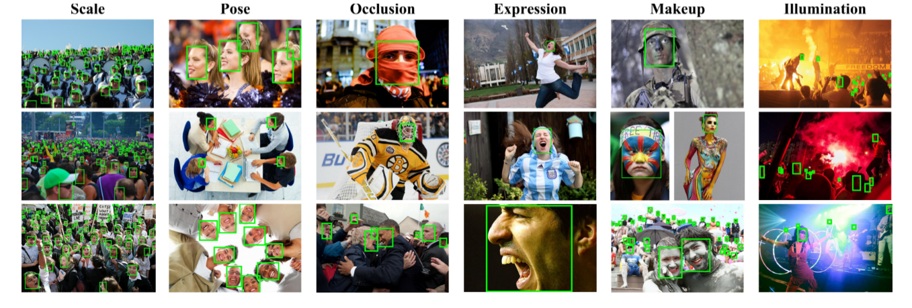
FDDB
WIDER FACE
AFW

Slide 8
The Proposed Face Classificaiton Benchmark (FCB)
1. RPN network is trained to extract face proposals [1,2]
2. Generic object proposal generating methods such as [3] are not suitable
Rare true faces
Ren S, He K, Girshick R, et al. Faster R-CNN: Towards real-time object detec-tion with region proposal networks. NIPS 2015.
Jiang H, Learned-Miller E. Face Detection with the Faster R-CNN. arXiv 2016.
Van de Sande K E A, Uijlings J R R, Gevers T, et al. Segmentation as selectivesearch for object recognition. ICCV 2011.
Notes:
1. RPN network is employed to extract proposals inspired by the work of Faster-RCNN [1] and its recent application in face detection [2]
2. Generic object proposal-generating methods such as [3] are not very suitable for our benchmark because the amount of positive patches generated is too scarce and those are not as discrimative as a specially trained RPN face proposal network

Slide 9
Some Specifics
Using Zeiler and Fergus model [1]
Extracted from the WIDER FACE [2]
1. Zeiler M D, Fergus R. Visualizing and understanding convolutional networks. ECCV 2014.
2. Yang, Shuo and Luo, Ping and Loy, Chen Change and Tang, Xiaoou. WIDER FACE: A Face Detection Benchmark. CVPR 2016.
Notes:
2. All proposals are generated from the training set of WIDER FACE [2] containing 12880 high-resolution images

Slide 10
3. IOU Criteria:
>0.5 ➔ face patch
<0.3 ➔ non face patch
4. Final FCB: 3,558,142 proposals, ~300 proposals per image
Notes:
4. Measure Intersection over Union (IOU) between a proposal generated by RPN and a ground truth to determine positive and negative samples
5. The proposed Face Classification Benchmark contains 3,558,142 proposals in total, of which 198,616 being face patches. All images are resized to 24x24

Slide 11
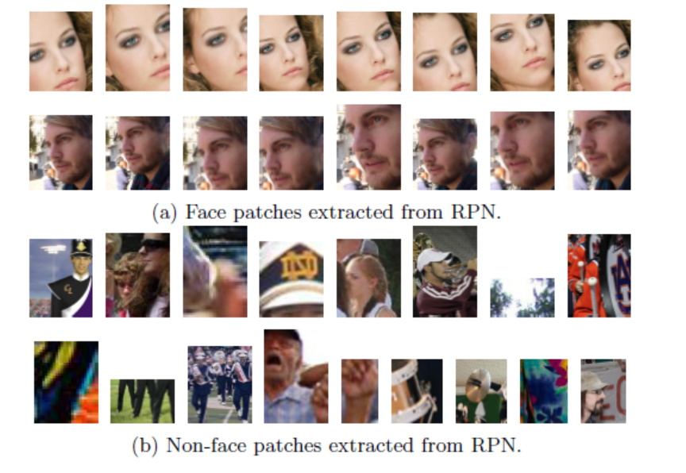
Sample Patches From FCB

Slide 12
Benchmark Protocol
1. Half for training, the other half for test
2. Evaluation metrics: FAR and TPR
3. Looking at FAR=10⁻³ , FPPI ~= 0.28
Notes:
Proposals from the first 6440 images are used as training set, while the remaining proposals from the rest 6440 images are used as testing set.
In the testing set, the size of Non-face patches are about 20 times the size of face patches. Therefore, if an algorithm classifies all positive samples as negative ones, it would still get 95% two class classification accuracy!
To reveal the ’true’ performance of a face classiﬁer, we put stress on per-formance at low False Accept Rate (FAR). The performance of the proposed algorithms are displayed via ROC curve by vary-ing the conﬁdent score threshold, with FAR in log space being the x axis and True Positive Rate (TPR) being the y axis.
Speciﬁcally, we measure the true positive rate at FAR=10−3 to compare the performance of diﬀerent algorithms. Since there are altogether 1,779,071 proposals extracted from 6,440 images in the test set, it means we only allow for False Positive Per Image (FPPI) of 0.28 in an image, which is both challenging and persuasive in terms of real world applications.

Slide 13
Evaluation
Traditional Methods:
Features: LBP, MB-LBP, NPD, LOMO
Classifiers: SVM, DQT+AdaBoost
Notes:
Illumination-invariance is obtained in LOMO [1] by applying the Retinex transform and the Scale Invariant Local Ternary Pattern (SILTP) for feature representation.
NPD [2] gives the nice properties of scale-invariance, bounded-ness and its feature involves only two pixel values, hence robust to occlusion and blur or low image resolution.
LBP [3] and MB-LBP [4] are also re-implemented for evaluation.
We adopt DQT+boosting [2] as our baseline classiﬁer.
We also tried SVM, but it appears to be not eﬀective to handle this challenging problem, and it is also not eﬃcient for our large-scale data. Therefore, we leaved SVM out ﬁnally.

Slide 14
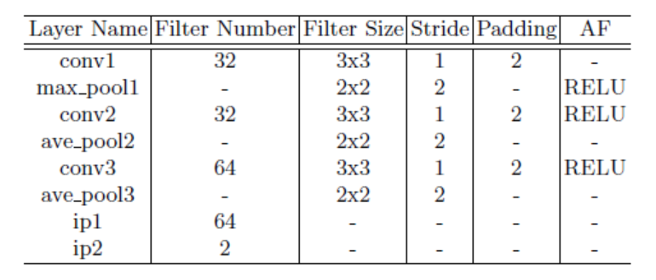
CNN Methods:
CIFAR-10 Net based binary classiﬁcation CNN [1]
Cascade-CNN [2]
The CIFAR-10 dataset, https://www.cs.toronto.edu/~kriz/cifar.html
Li H, Lin Z, Shen X, et al. A convolutional neural network cascade for face detection, CVPR 2015.

Slide 15
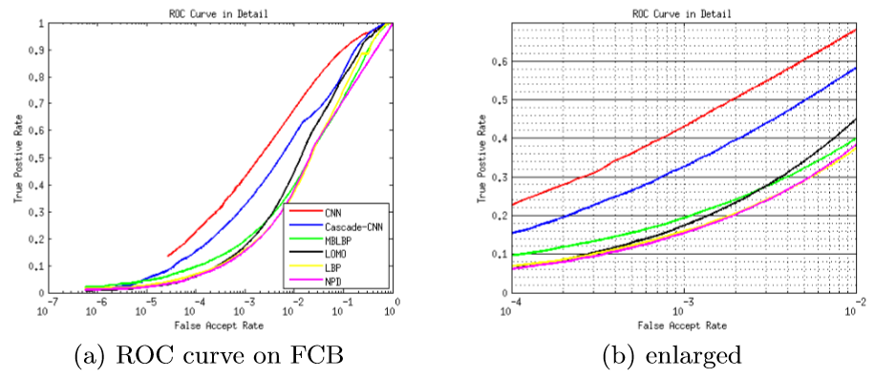
Results
Notes:
CIFAR-10 based CNN beats other methods due to its powerful representation ability
It also outperforms Cascade-CNN by a large margin. This is probably because in the process of cascade training, hard negative samples mined by the last net contain a proportion of non-face patch-es that actually contain faces but with a IOU less than 0.3, thus ’too hard’ to identify for a shallow net structure

Slide 16
Detection rates (%) at FAR=10⁻³
Top 1: CIFAR-10 Net, but still poor!!
Top 2: Cascade-CNN
Traditional features: MB-LBP and LOMO slightly better
Notes:
1. As for hand-crafted features, MB-LBP obtains about 20% detection rate compared to LBP (about 16%) detection rate at FAR of 10e−3
2. At FAR of 10−3, LOMO performs slightly better than LBP, but its true positive rate increases rapidly as we move along the righthand direction of x axis.
3. NPD achieves comparable performance compared to LBP. As its values are computed involv-ing only two pixels of an image, NPD is more sensitive than other algorithms considering that face patches on FCB are not aligned.
4. At FAR of 10−2, the over-all rank is almost the same except that LOMO performs better than MB-LBP.

Slide 17
Model details and speed of each algorithm
Notes:
1. About the dimension of the original features and selected features by the DQT based AdaBoost, as well as the training time, testing time and platform of each algorithm employed in our evaluation.
2. Note that LOMO requires RGB images while other methods use gray images as input.
3. The ﬁrst 4 algorithms are all combination of feature extraction and boosting with Deep Quadratic Trees (DQT) while the last two are end to end CNN methods, therefore the dimension of original features and selected features are the same.

Slide 18
Conclusions
A benchmark dataset
>3.5 millions of samples
Face classiﬁcation only
Data and code released
2. Face classiﬁcation alone is still poor
3. Pre-processing and post-processing is important for face detection
4. Therefore, face classiﬁcation needs to be separately evaluated
Notes:
1. It is not easy to determine the actual performance of the face classiﬁcation part due to the large inﬂuence of block generation and post-processing in traditional benchmarks. Motivated by this, we conduct a special-ized benchmark study in this paper, which focuses purely on face classiﬁcation.
2. We start with face proposals by collecting about 3.5 millions of face and non-face sample patches, and build a benchmark dataset (FCB) for two-class face classi-ﬁcation evaluation.
3. Our results show that, without the help of post-processing, the performance of face classiﬁcation itself is still not very satisfactory, even with a powerful CNN method.
4. The data and evaluation code of this study will be re-leased to the public to help assess performance of face classiﬁcation, and ease the participation of other related researchers who want to try their algorithms for face detection.

Slide 19
Face Classification: A Specialized Benchmark Study
Jiali Duan, Shengcai Liao, Shuai Zhou, and Stan Z. Li
Center for Biometrics and Security Research
Institute of Automation, Chinese Academy of Sciences
Project Page: https://davidsonic.github.io/index/ccbr_2016

